Slide 1
Development and Testing of a Comprehensive Incident Response Plan

Slide 2


Slide 3

Members
1- Shehab Elden Hesham Hanafy
2- Momen Ahmed Abdelhady
3- Abdelfatah Mostafa Yahya
4- Zyad Sobhy Amin
5- Osama Hassan Yossef
Supervised by:
Eng/ Noureldin Essam.

Slide 4

Let's get started:

Slide 5
Introduction
In today’s evolving cyber threat landscape, organizations face persistent challenges in detecting, responding to, and recovering from security incidents. To effectively address these risks, it is crucial to establish a well-structured, proactive, and tested Incident Response (IR) Plan.

Slide 6
Objectives:
To analyze and summarize best practices in incident response based on NIST standards and other relevant frameworks.
To develop a structured and comprehensive Incident Response Plan addressing all major phases — preparation, detection, containment, eradication, recovery, and lessons learned.
To simulate and test real-world cyber incidents using Splunk SIEM and Caldera C2 to evaluate the plan’s effectiveness.

Slide 7
Scope:
focuses on the design, implementation, and testing of an Incident Response framework within a controlled lab environment. It covers:
Application of the NIST SP 800-61 framework as the core structure for the plan.
Utilization of Splunk for threat detection, event correlation, and log management.
Deployment of Caldera OR Kali as the attacker machine and C2 server to simulate adversarial behavior.

Slide 8
Common Attacks

Slide 9
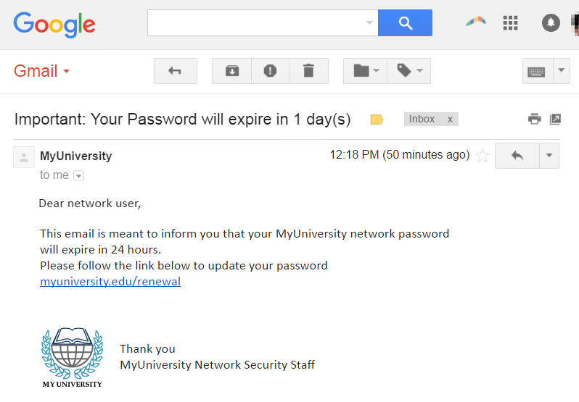
1- Phishing
Phishing is a type of cyber-attack aimed at deceiving users to obtain sensitive information such as passwords, credit card numbers, or other personal data. Usually, the attacker appears as a trusted entity (such as a bank, email service, or popular website) to convince the victim to disclose their information.

Slide 10
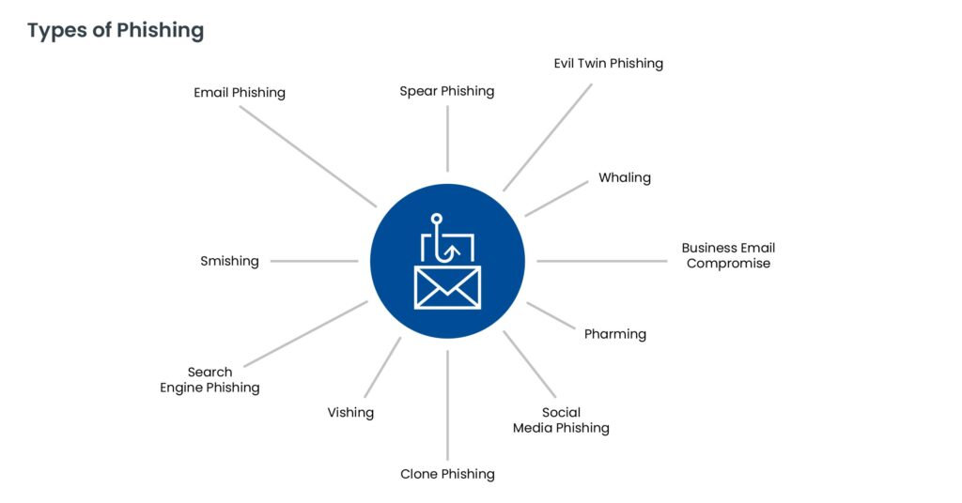
Types of Phishing Attacks:

Slide 11
DDOS ATTACk
A DDoS attack is an attempt to stop a service or website from functioning by sending a massive number of requests that exceed the server's capacity to handle them, making the site or service unavailable to legitimate users.
Methods of Executing DDoS:
1- Volume-Based Attacks.
2- Protocol Attacks.
3- Application Layer Attacks.

Slide 12
Insider Attack
An Insider Attack is carried out by an employee or internal person with legitimate access to systems or data who exploits privileges for malicious purposes like data theft, sabotage, or espionage.
Methods of Executing:
1- Unauthorized Access.
2- Data Exfiltration.
3- System Sabotage.
4- Internal Espionage.

Slide 13
SQL Injection
SQL Injection is an attack on web applications where an attacker enters malicious SQL queries in input fields to manipulate the database and access or modify sensitive information.
Methods of Executing:
1- Classic SQL Injection. 2- Blind SQL Injection. 3- Error-Based SQL Injection. 4- Union-Based SQL Injection. 5- Time-Based SQL Injection.

Slide 14
Incident Response plan

Slide 15
Preparation
Develop policies (IRP, escalation procedures, communication plans).
Deploy SIEM/EDR and configure logging (Sysmon, Firewall, AD logs).
Harden systems (CIS Benchmarks, disabling unused services).
Conduct staff training and simulations.
Validate the availability of clean backups.
Build the IRT structure and define roles

Slide 16
Identification
Analyze SIEM/EDR alerts for suspicious activity.
Identify unusual patterns (failed logons, privilege escalation, process injections).
Validate IOCs (IPs, hashes, domains).
Assign severity level.
Analyzing and Prioritizing

Slide 17
Containment
Isolate affected hosts (EDR → Network Isolation).
Kill malicious processes.
Block C2 IPs/domains.
Temporarily disable vulnerable services.
Disable compromised accounts.
Add new detections to SIEM.

Slide 18
Eradication
Delete malware and any remnants.
Remove persistence:
Registry Run keys
Scheduled Tasks
Startup folders
WMI persistence
Patch exploited vulnerabilities.
Clean affected files or reinstall OS if needed.
Verify no malicious activity remains.

Slide 19
Recovery
Restore from clean backups or golden images.
Rebuild compromised servers if necessary.
Validate applications/services functionality.
Monitor logs and EDR events for 48–72 hours.

Slide 20
Lessons Learned
Conduct review meeting (within 48 hours).
Identify what worked / what failed.
Update policies, playbooks, and detection rules.
Add new IOCs, TTPs, and YARA/SIEM rules.
Document the full timeline and impact.

Slide 21
Simulation Environment Preparation

Slide 22

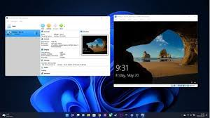

Environment Components
1-Splunk Server (Ubuntu) 2-Windows VM (Victim Machine) 3-Kali linux (attack)

Slide 23
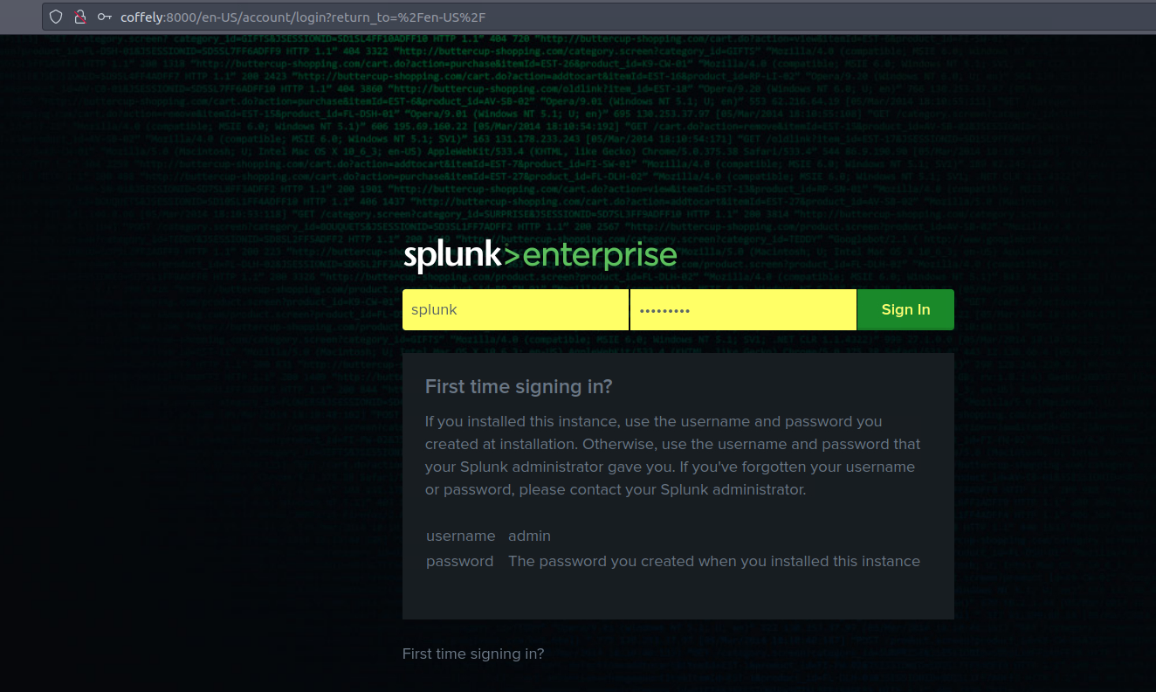
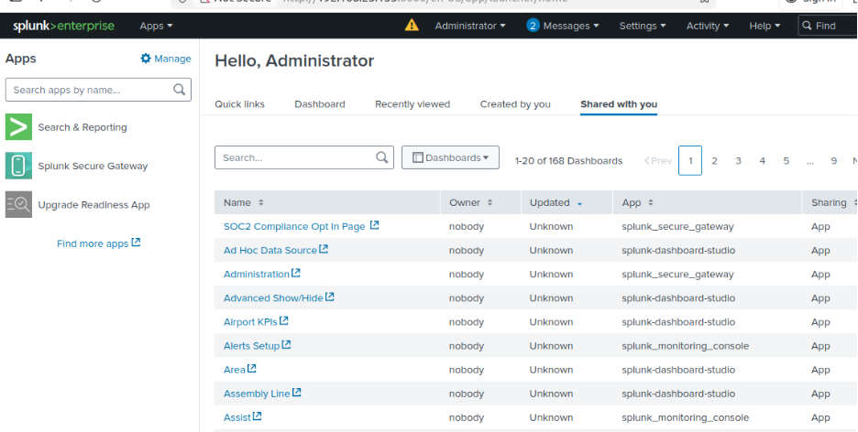
1- Splunk server

Slide 24
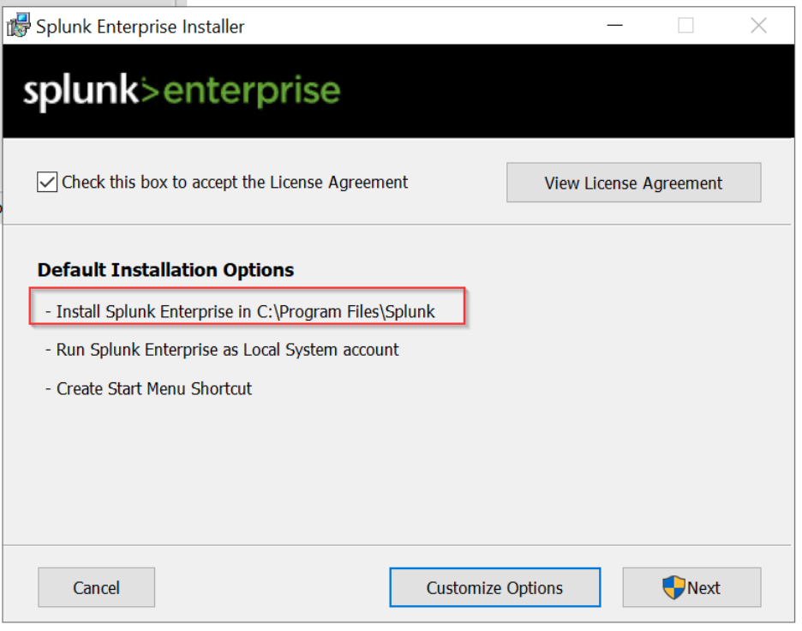
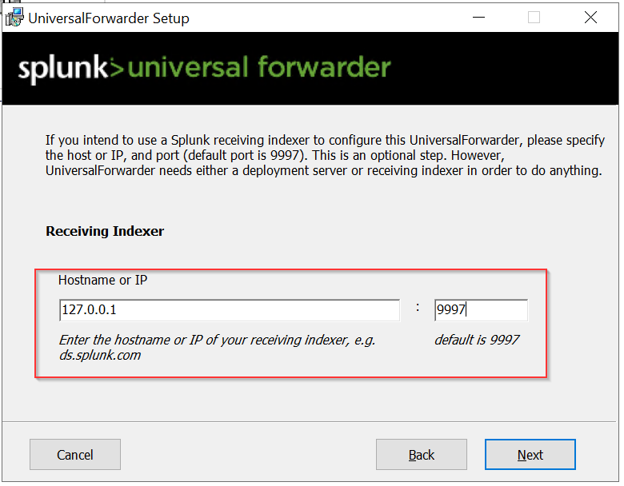
2-windows vm
First download Universal Forwarder:

Slide 25
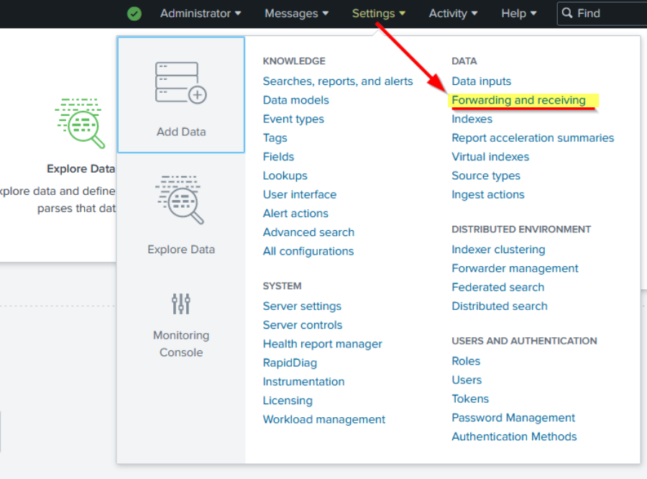
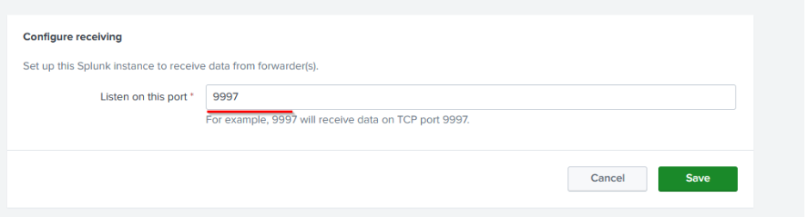
Second configure the receiver on Splunk so the forwarder knows where to send the data.

Slide 26
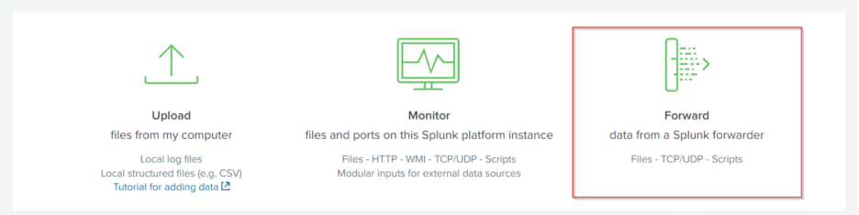
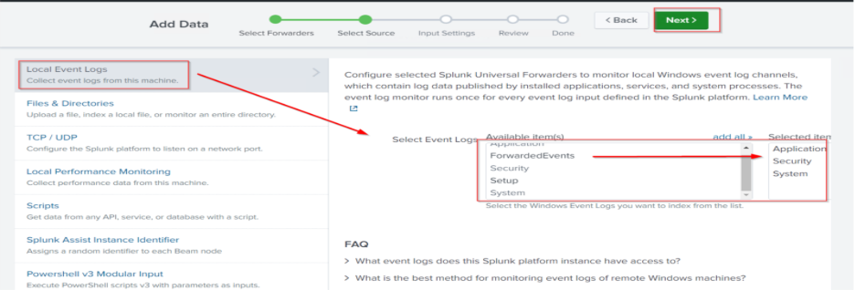
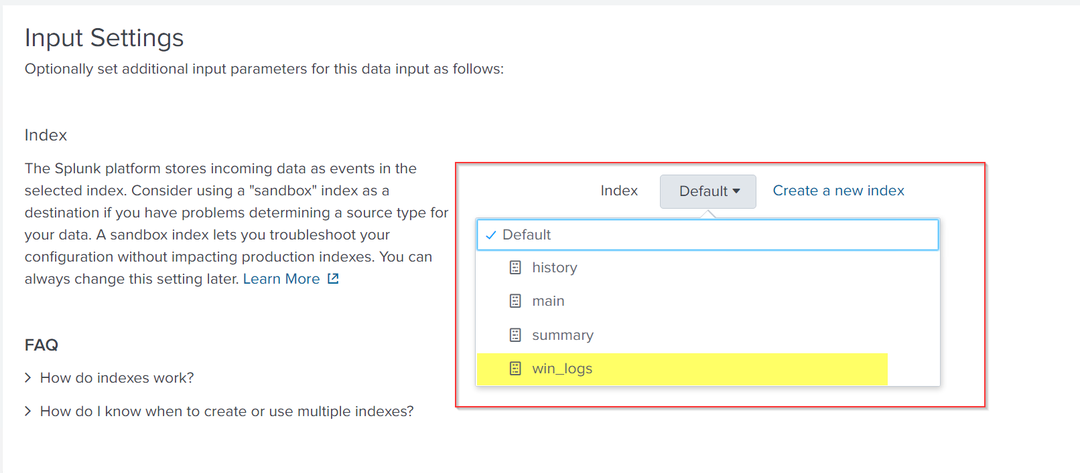
Third Add Log Sources:
Notes:
Simplification

Slide 27
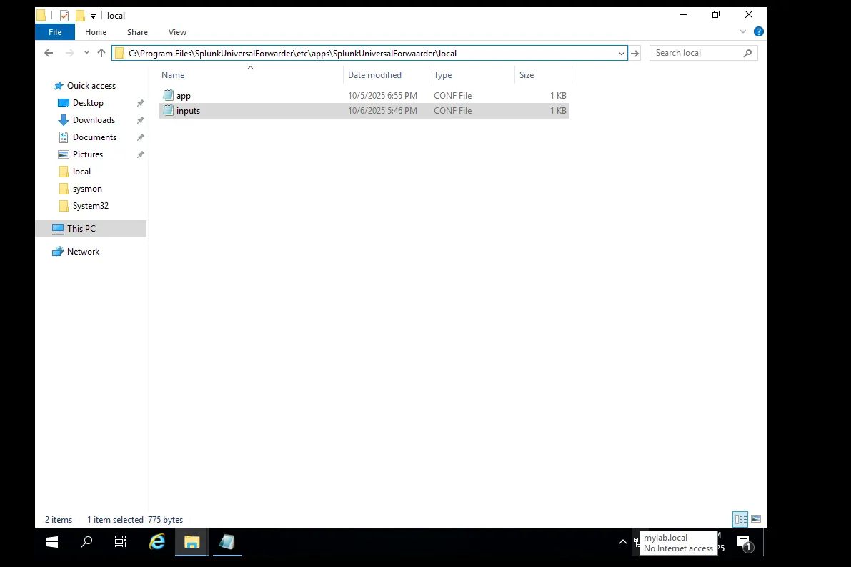
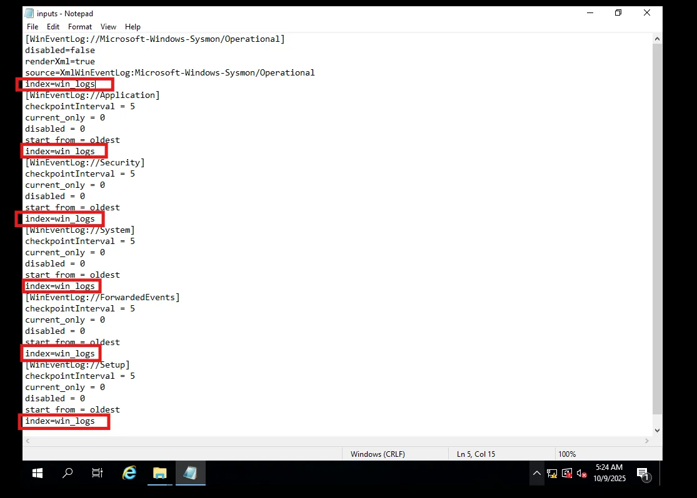
Fourth integrated Sysmon with Splunk server

Slide 28
Attacks Scenarios

Slide 29
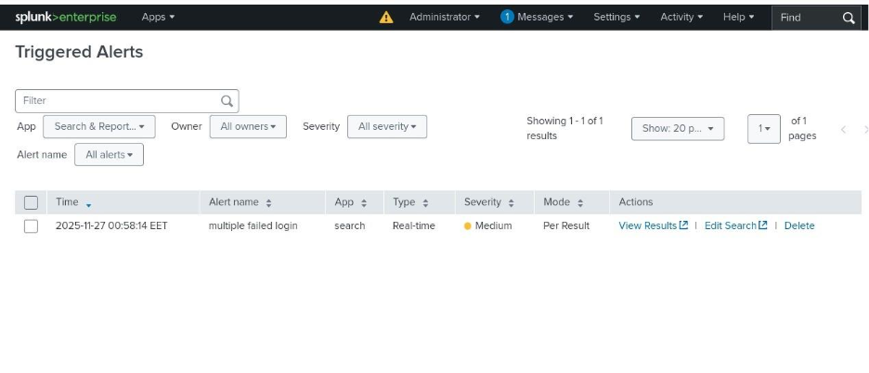
1-Brute Force Attack
An alert was triggered indicating multiple failed logins attempts that could represent a potential brute‑force attack. The logs showed 5 failed login attempts followed by 1 successful login from same user.

Slide 30
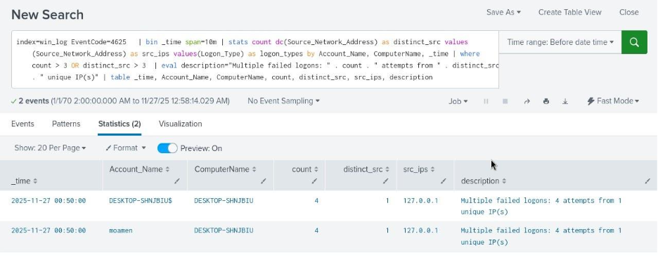

Slide 31
2-MSFvenom Reverse Shells using kali
MSFvenom is a command‑line tool in the Metasploit Framework used to generate, encode, and package payloads.
A reverse shell is a connection initiated by the victim machine back to the attacker. Once connected, the attacker gains command-line access for testing post-exploitation behavior.

Slide 32
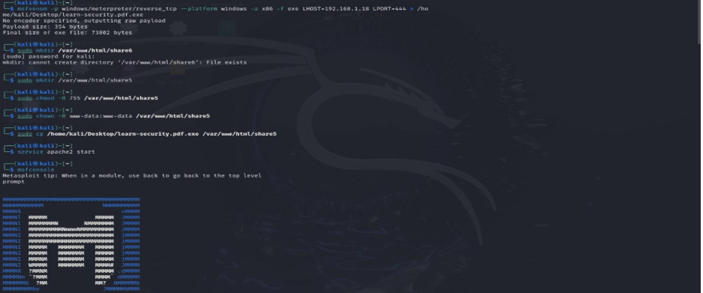
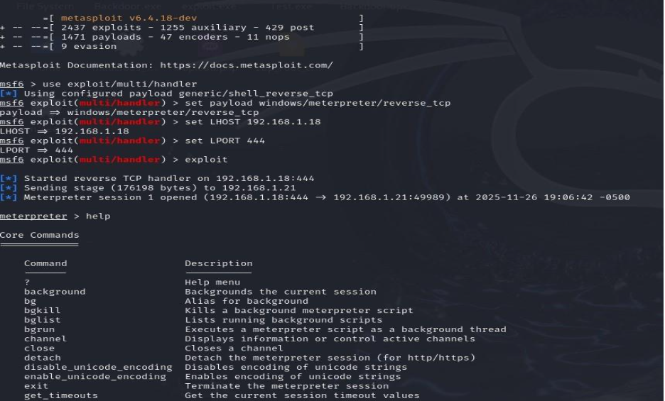
First create payload to send to victi m

Slide 33
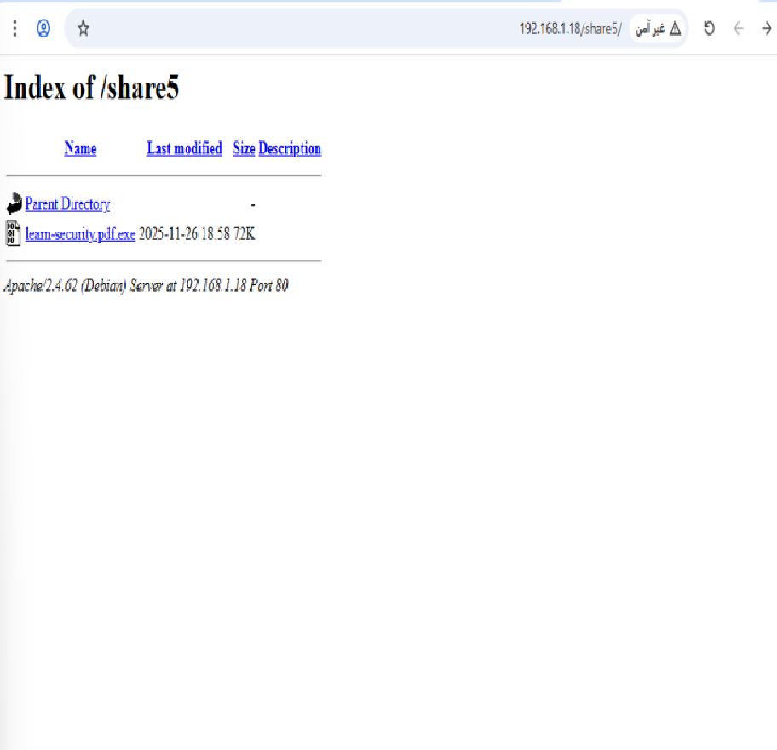
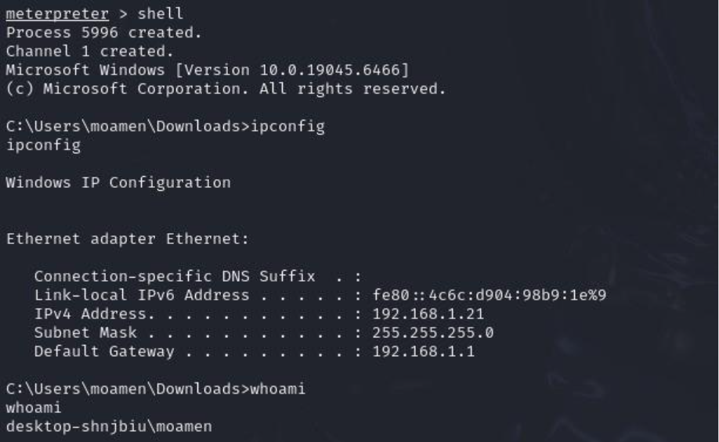
Second victim open the link, download file and opened it. When he opened file, attacker able to run commands.

Slide 34
investigation

Slide 35
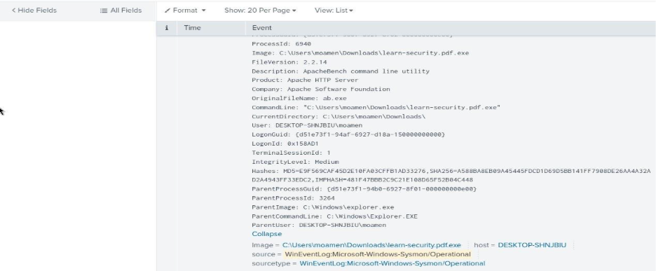
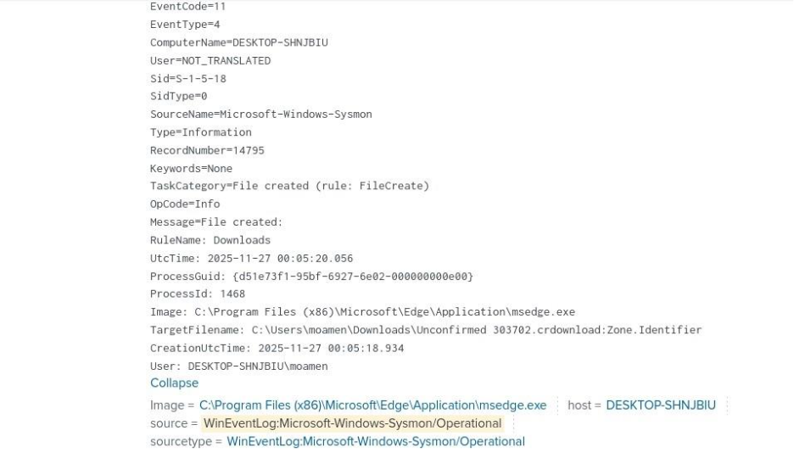
Eventcode=1

Slide 36
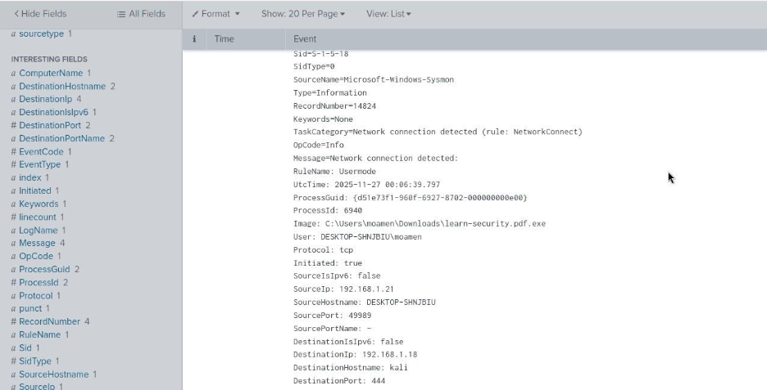
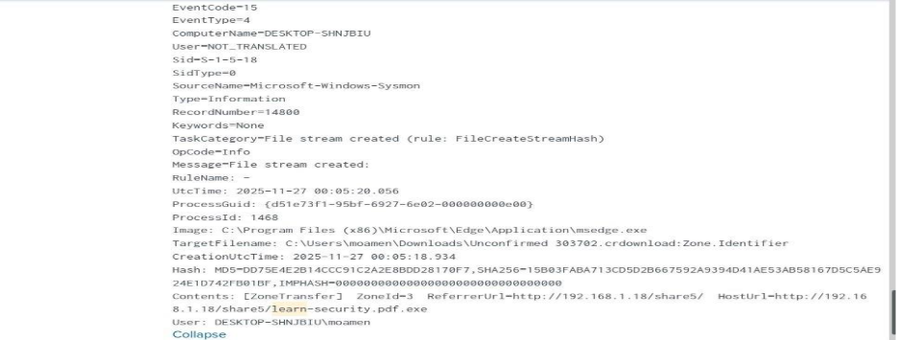
Eventcode 3

Slide 37
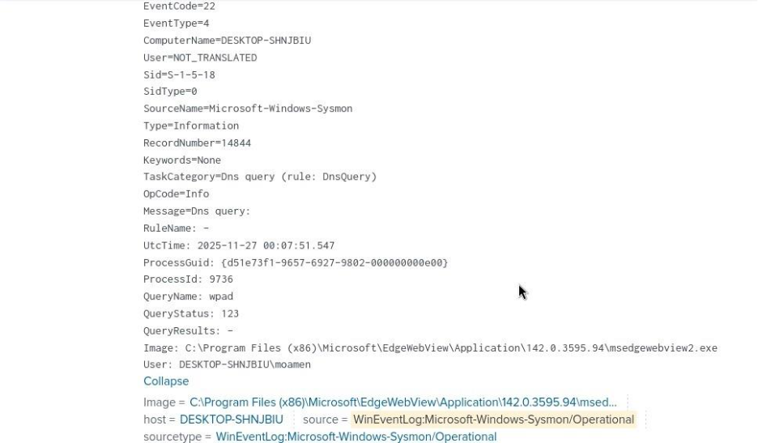

Slide 38
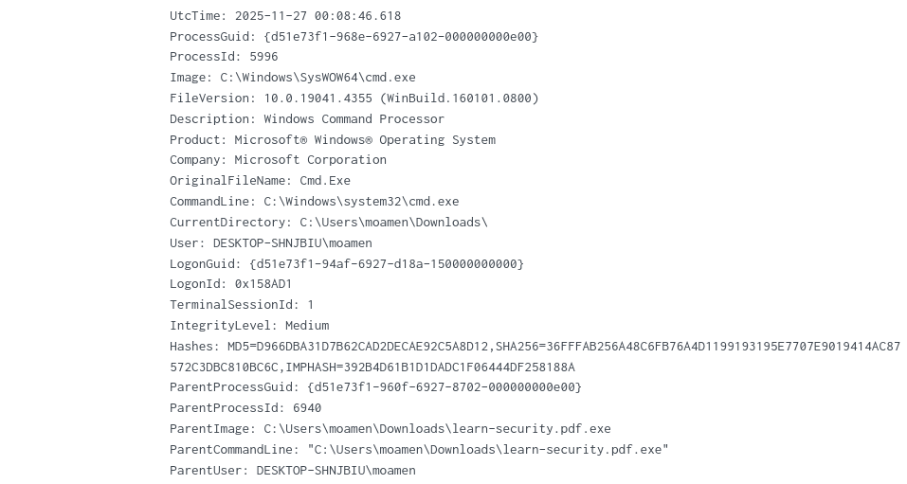
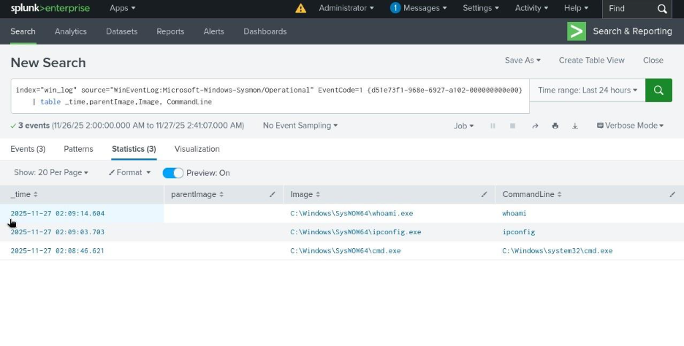

Slide 39


